Slide 1


Supermart Sales Analytics & Netflix Content Analysis Nilay Saha | August 24, 2025
Data SCIENCE Internship Project

Slide 2
Presentation Overview
Project 1: Supermart Grocery Sales – Analyze sales data to identify key trends and top-performing categories.
Project 2: Netflix Content Analysis – Explore dataset to understand composition and growth of its content library.
Overall Conclusion

Slide 3

Project 1: Supermart Grocery Sales
A Deep Dive into Retail Analytics

Slide 4
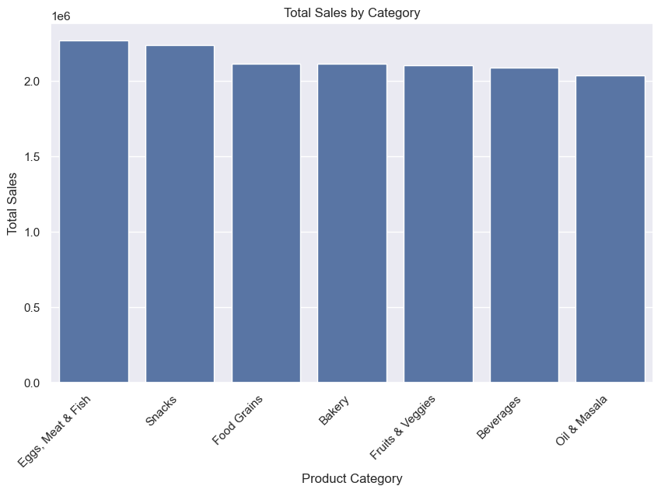
'Eggs, Meat & Fish' is the Highest-Grossing Category
Key Insight: This category, along with Snacks and Food Grains, are primary revenue drivers and indicate high demand.

Slide 5
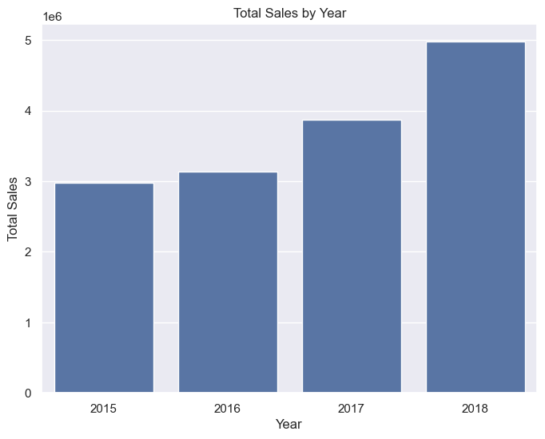
Sales Have Grown Steadily, Peaking in 2018
Key Insight: Strong growth trend, with most sales from 2017 and 2018.

Slide 6
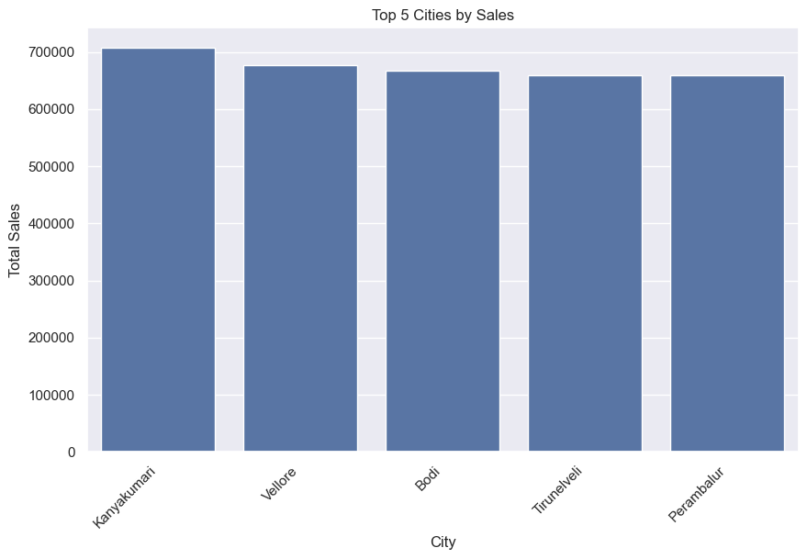
Kanyakumari is the #1 City for Sales
Key Insight: Top 5 cities represent the most significant markets where focus should be prioritized.

Slide 7
Actionable Recommendations
Focus on Top Categories: Increase stock and marketing for 'Eggs, Meat & Fish'.
Invest in Key Markets: Targeted campaigns for the top 5 cities.
Optimize Discount Strategy: Ensure promotions don’t hurt profitability.

Slide 8

Project 2: Netflix Content Analysis
Understanding the Streaming Giant's Library

Slide 9
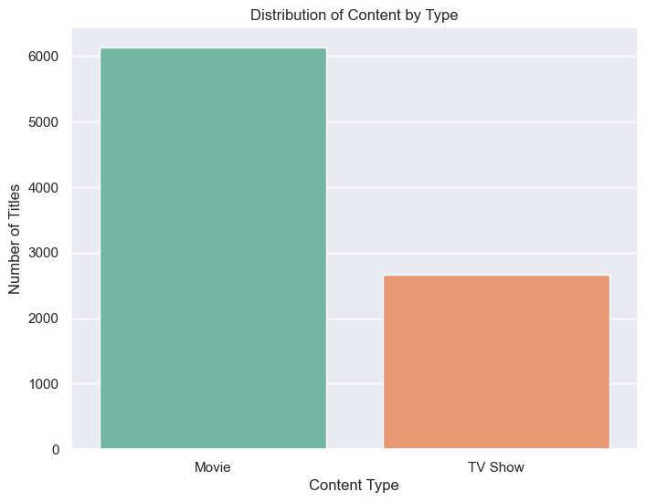
The Netflix Library is Predominantly Movies
Key Insight: Movies make up ~70% of the content, dominating over TV shows.

Slide 10
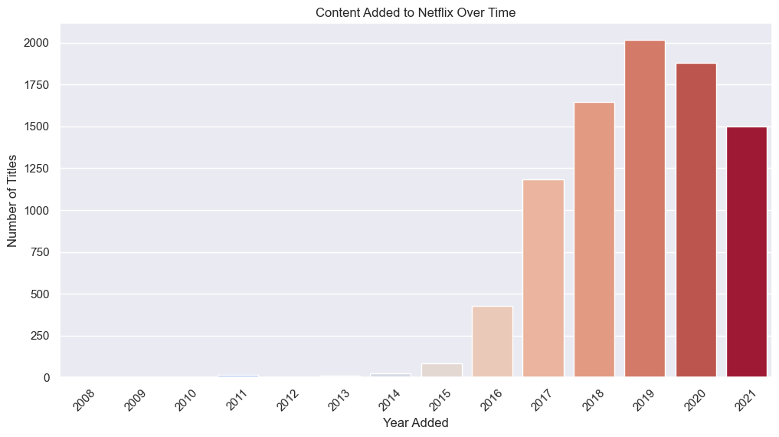
Massive Content Expansion from 2016-2019
Key Insight: Titles grew exponentially during this period, reflecting a major strategic push.

Slide 11
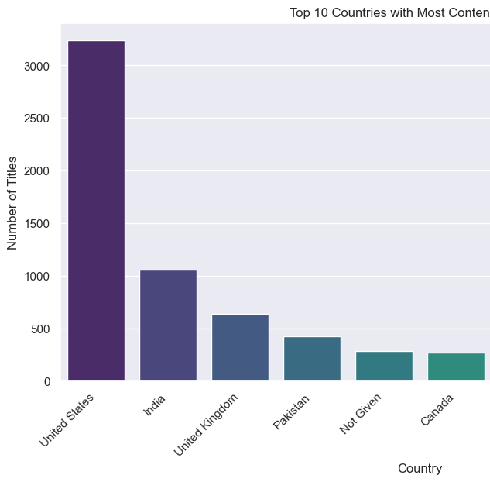
The U.S. and India Dominate Content Production
Key Insight: U.S. is the largest contributor; India highlights importance as a global market.

Slide 12
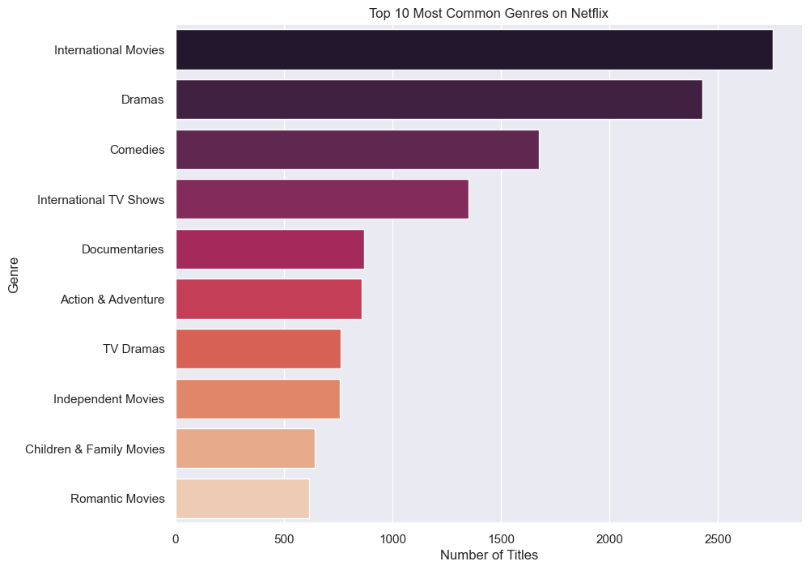
'International Movies' and 'Dramas' are the Top Genres
Key Insight: Reflects Netflix’s global strategy and broad audience appeal.

Slide 13
Conclusion on Netflix Content Strategy
Movie-heavy platform with rapid global growth.
01
Led by content from U.S. and India.
02
Aimed largely at mature audiences.
03
Focus on internationally appealing dramas.
04

Slide 14

Project Summary & Skills Demonstrated
Completed two end-to-end data analysis projects.
Performed data cleaning, preparation, and exploratory analysis.
Created insightful visualizations to communicate findings.
Derived actionable recommendations from data-driven insights.

Slide 15

Thank You

